Slide 1




NEXT GEN EMPLOYABILITY PROGRAM
Creating a future-ready workforce
Team Members
College Name
Student Name : EBONICA SALETH V
Student ID : au511321104025
5113 – KINGSTON ENGINEERING COLLEGE

Slide 2

CAPSTONE PROJECT SHOWCASE
Project Title
Building Bus Reservation System using Python and Django
Abstract | Problem Statement | Project Overview | Proposed Solution | Technology Used | Modelling & Results | Conclusion

Slide 3
Abstract
The Bus Reservation System in Django Framework is a web application designed to streamline the process of booking bus tickets. Built using Django, a Python-based web framework, the system provides users with a convenient platform to search for available buses, make bookings, view their bookings, and cancel them if needed.
The system comprises several key functionalities:
1. User Authentication: Users can create accounts, log in, and log out securely. Authentication is managed through Django's built-in authentication system.
2. Finding Buses: Users can search for available buses by specifying their departure and destination locations, along with the desired date of travel.
3. Making Bookings: Once users find suitable buses, they can book seats by providing the necessary details such as the number of seats required.
4. Viewing Bookings: Users can view their current bookings, including details such as the bus name, source, destination, number of seats, price, date, time, and booking status.
5. Canceling Bookings: If users need to change their plans, they have the option to cancel their bookings, provided the cancellation is within the allowed timeframe.
Overall, the Bus Reservation System in Django Framework offers a user-friendly and efficient solution for booking bus tickets, enhancing the travel experience for users.
Source :

Slide 4
Problem Statement
Traditional bus ticket booking methods often lead to inefficiencies and frustrations for both passengers and bus operators due to long queues, manual paperwork, and limited access to real-time information. To address these challenges, there is a need for a modernized Bus Reservation System developed using the Django Framework. This system aims to provide passengers with a seamless online booking experience while enabling bus operators to efficiently manage their operations.
The main goal of this project is to develop a user-friendly Bus Reservation System that simplifies the booking process for passengers. By offering real-time updates on bus schedules, seat availability, and fares, passengers can make informed decisions quickly and easily. Automation features such as seat allocation and ticket generation will streamline operations, enhancing efficiency for both passengers and bus operators.
Security and data privacy are paramount considerations in the design of the Bus Reservation System. Stringent security measures will be implemented to protect user data. Additionally, the system will be built with scalability and maintenance in mind to accommodate future enhancements and technological advancements.
Overall, the proposed Bus Reservation System aims to revolutionize bus ticket booking by providing a modern, efficient, and secure platform for passengers while empowering bus operators with tools to optimize their operations and deliver superior service.
Source :

Slide 5
Project Overview
The Bus Reservation System, built using Django Framework, is a cutting-edge solution aiming to streamline the bus ticket booking process. With a sleek and user-friendly interface, passengers can effortlessly search for buses, check seat availability, and book tickets online. The system offers real-time updates on bus schedules and booking status, ensuring passengers are always informed. Moreover, it provides automated seat allocation to optimize seating capacity and minimize manual intervention.
Ensuring security and scalability, the system implements robust measures such as data encryption and secure authentication. This guarantees the protection of user information and transactions. Additionally, the architecture is designed for scalability, allowing seamless expansion and integration of new features as the user base grows.
For bus operators, the system offers an admin panel for managing schedules, updating fares, and tracking bookings. This empowers operators to efficiently manage their operations while enhancing customer service. Overall, the Bus Reservation System revolutionizes bus travel by providing a modern and efficient platform for booking tickets and managing travel arrangements.
Source :

Slide 6
Proposed Solution
The Bus Reservation System is a comprehensive web-based platform designed to address the inefficiencies and challenges encountered in the bus ticket booking process. It aims to provide a seamless experience for both passengers and bus operators, offering convenience, reliability, and efficiency throughout the booking and management process. The current bus ticket booking process is fraught with challenges for both passengers and bus operators. Passengers often struggle with limited access to real-time information on bus schedules and seat availability, leading to uncertainty and inconvenience. Additionally, concerns about the security of personal data and online transactions remain prevalent. On the other hand, bus operators face difficulties in managing bookings, updating schedules, and maximizing the utilization of their fleet.
User-Friendly Interface:
The system boasts an intuitive and responsive web interface, ensuring seamless access across various devices such as desktops, laptops, tablets, and smartphones. Users can easily navigate through the platform to search for buses, view schedules, check seat availability, and complete bookings with minimal effort.
.
Source :

Slide 7
Real-Time Updates: Passengers benefit from real-time updates on bus schedules, seat availability, and booking status. By providing instant access to accurate information, the system enables passengers to make informed decisions and plan their travel efficiently. Bus operators can also update schedules and manage bookings in real-time, ensuring timely updates for passengers.
Secure Authentication: To ensure data security and prevent unauthorized access, the system incorporates robust authentication mechanisms. Users are required to authenticate themselves securely before accessing booking functionalities, protecting their personal information and ensuring confidentiality.
Admin Panel: Bus operators have access to a centralized administrative dashboard, where they can manage schedules, update fares, track bookings, and analyze performance metrics. The dashboard provides valuable insights into operational efficiency, allowing operators to make data-driven decisions and improve service quality.
Scalable Architecture: Designed with scalability in mind, the system utilizes a modular and flexible architecture that can accommodate increasing user demand and future expansion. This ensures that the system remains responsive and reliable even as the user base grows over time.
Source :

Slide 8
The Bus Reservation System features:
User-Friendly Interface: It provides a seamless booking experience across devices, enabling users to easily search for buses, check schedules, and make reservations.
Real-Time Updates: Passengers receive instant updates on bus schedules and seat availability, ensuring they have the most accurate information to plan their travel.
Secure Authentication: Robust authentication mechanisms safeguard user data, ensuring confidentiality and protecting against unauthorized access.
Centralized Admin Panel: Bus operators benefit from a centralized dashboard to manage schedules, update fares, track bookings, and analyze performance metrics, enhancing operational efficiency.
Scalable Architecture: The system is built on a modular and flexible architecture, allowing it to scale seamlessly to accommodate growing user demand and future expansion.
Benefits:
Convenience
Efficiency
Transparency
Cost-effectiveness
Enhanced customer satisfaction.
Source :

Slide 9


Technology Used
Front-end
Back-end
Source :

Slide 10
Modelling & Results
The Bus Reservation System implements a comprehensive data model to manage various facets of the booking process efficiently. At its core, the system comprises several key components designed to facilitate seamless interactions between passengers and bus operators.
Firstly, the system centralizes bus schedule management, storing detailed information such as departure times, routes, and seat availability for each trip. This data is continuously updated in real-time to reflect any changes in schedules or seat availability, ensuring accuracy and reliability throughout the booking process.
Secondly, the system incorporates user account management functionality, allowing passengers to create and manage their accounts securely. Users can store personal information, view their booking history, and access preferences, enhancing the overall user experience and facilitating repeat bookings.
Moreover, the system includes robust booking management capabilities, enabling users to make reservations effortlessly. When users book seats, the system records pertinent details such as user information, selected seats, and trip specifics.
Additionally, the system provides bus operators with a comprehensive admin dashboard, empowering them to manage bus schedules, update fares, monitor bookings, and generate reports. In conclusion, the Bus Reservation System offers a sophisticated solution to streamline the bus booking process for both passengers and bus operators. Through its robust data model and user-friendly features, the system enhances efficiency, improves customer satisfaction, and enables data-driven decision-making in the bus transportation industry.
Source :

Slide 11
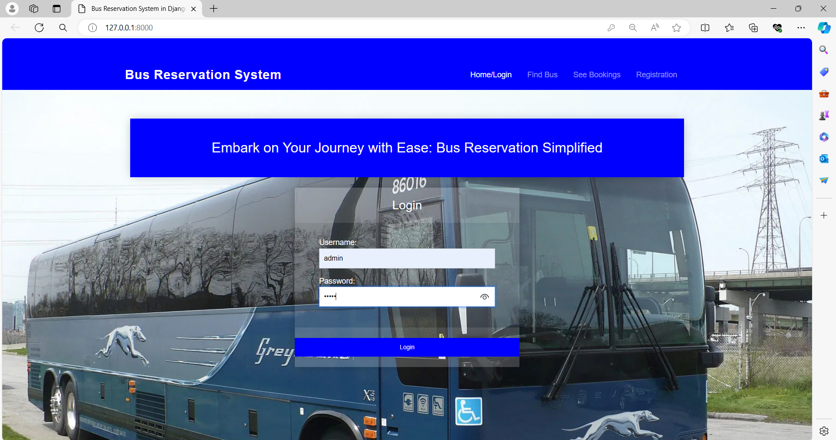
Homepage

Slide 12
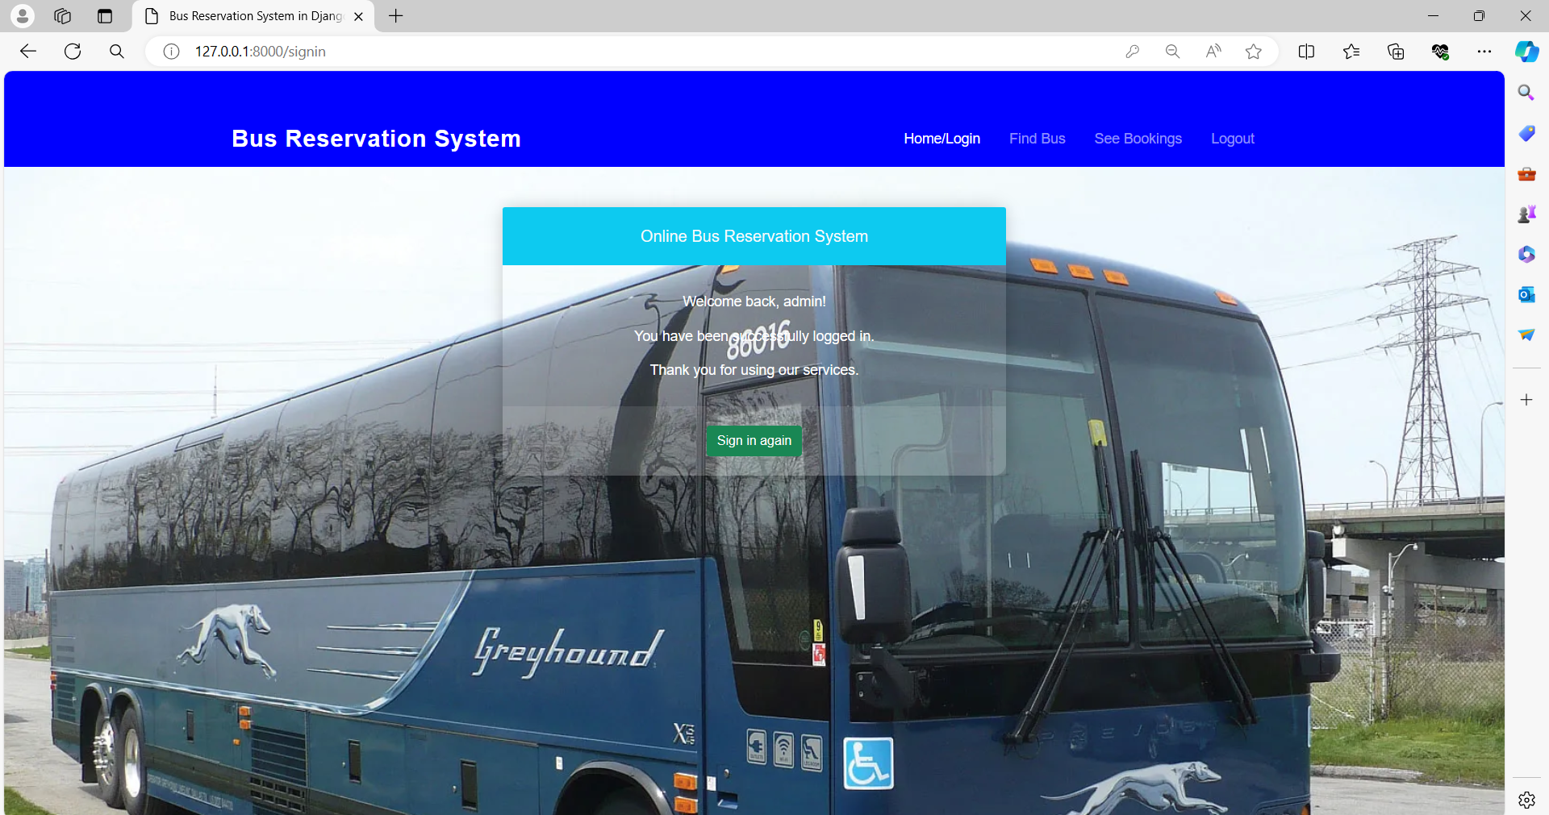
Admin Page

Slide 13
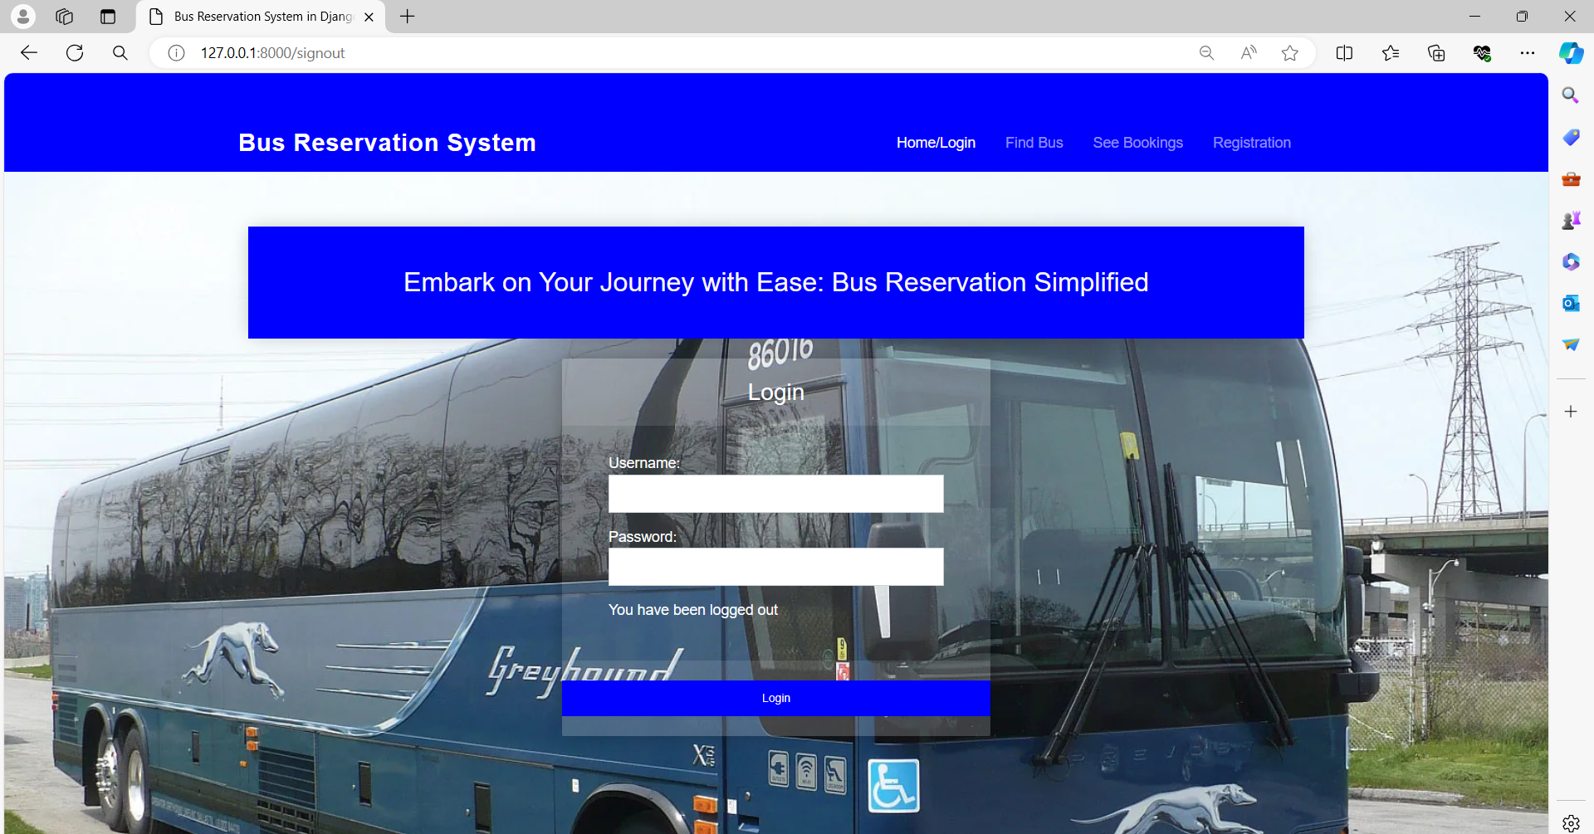
Login-Page

Slide 14
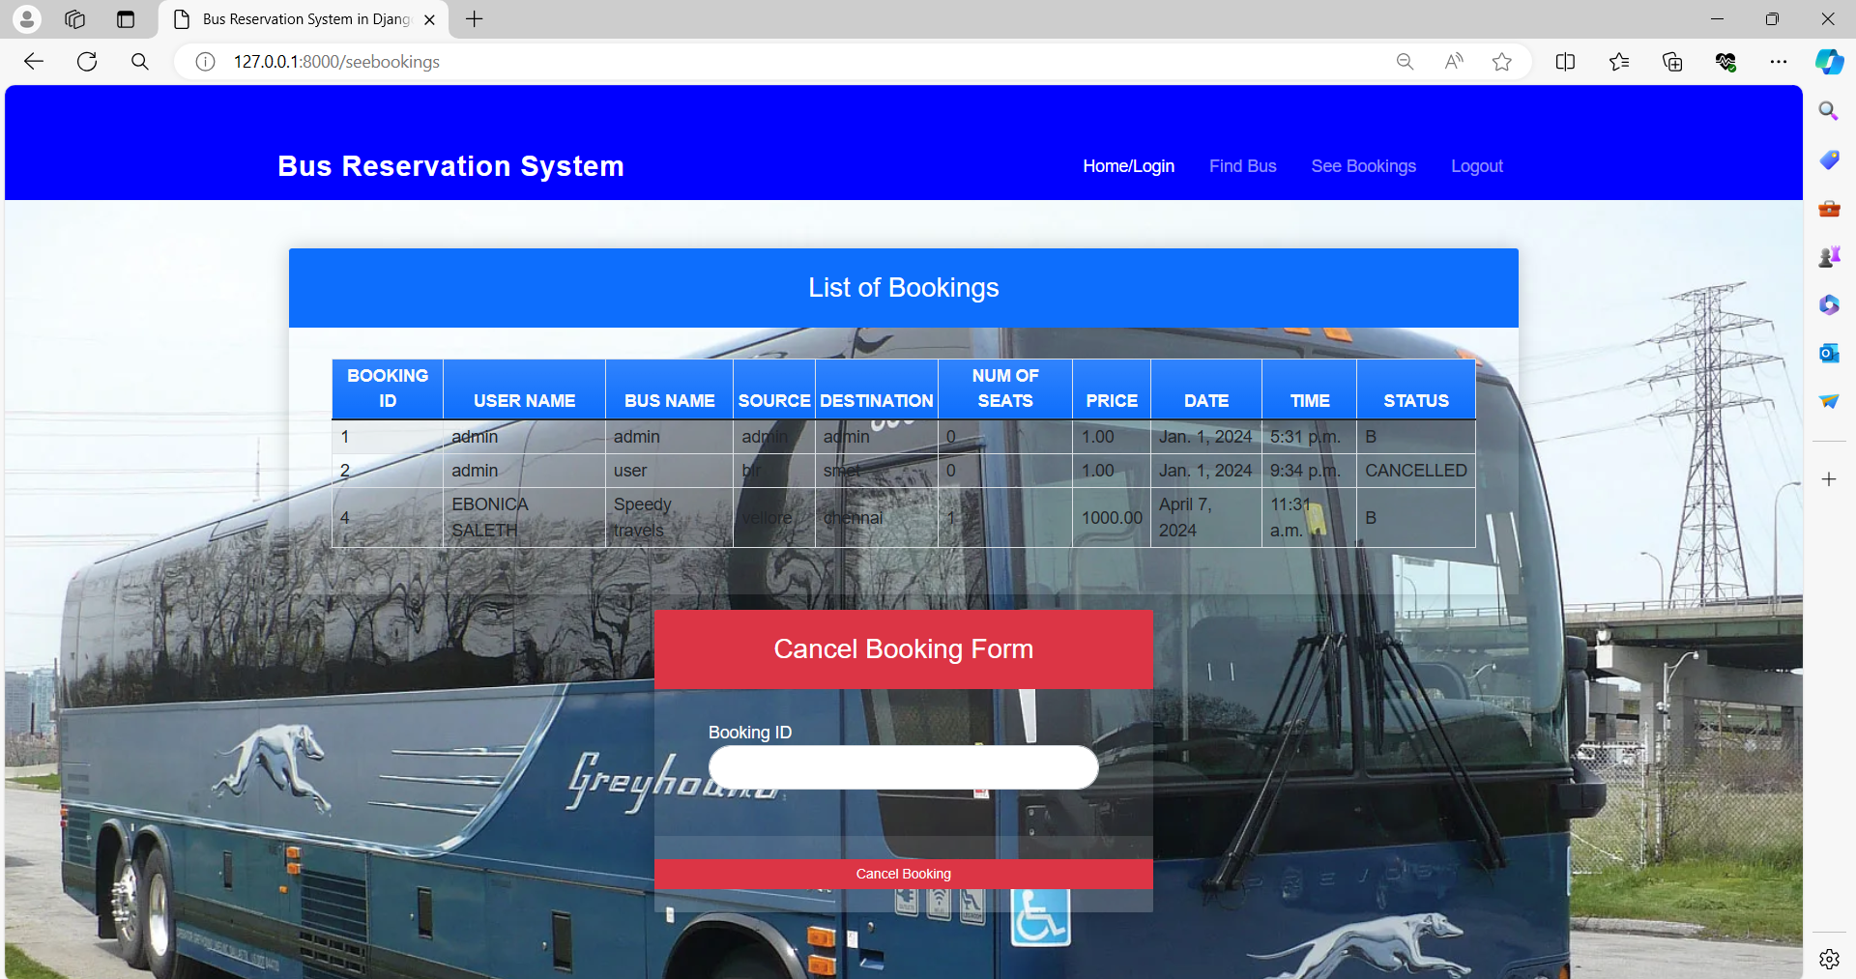
List of Booking-Page

Slide 15
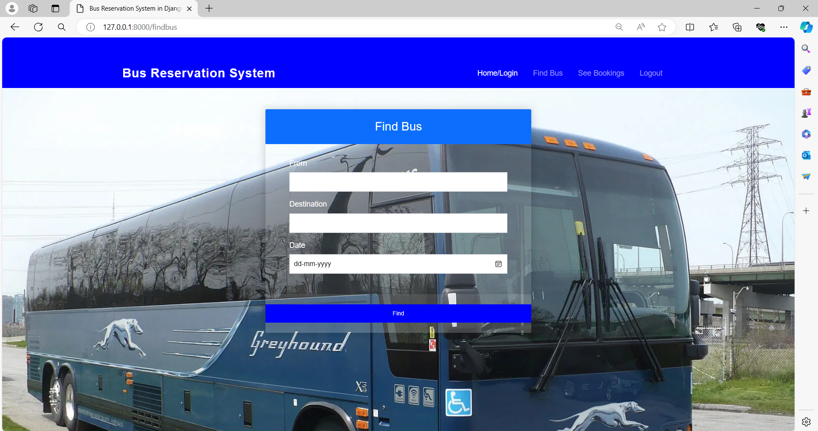
Finding the Buses-Page

Slide 16
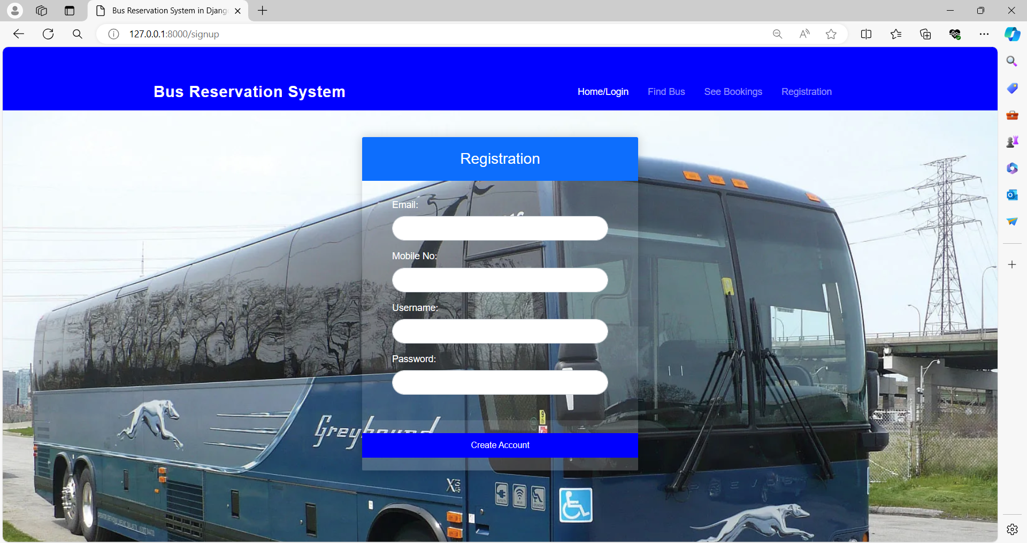
Registration-Page

Slide 17
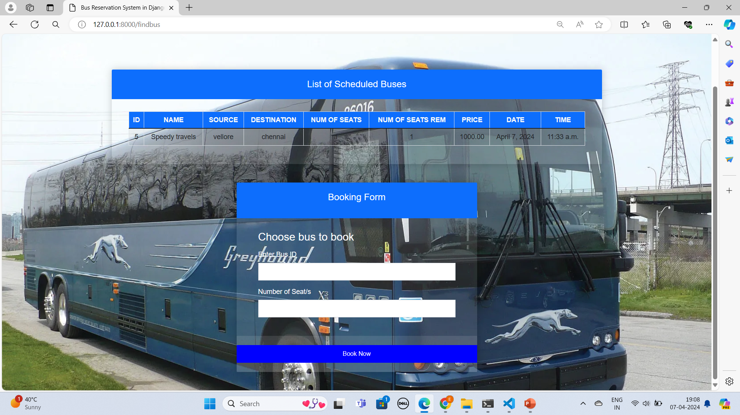
Booking form-Page

Slide 18
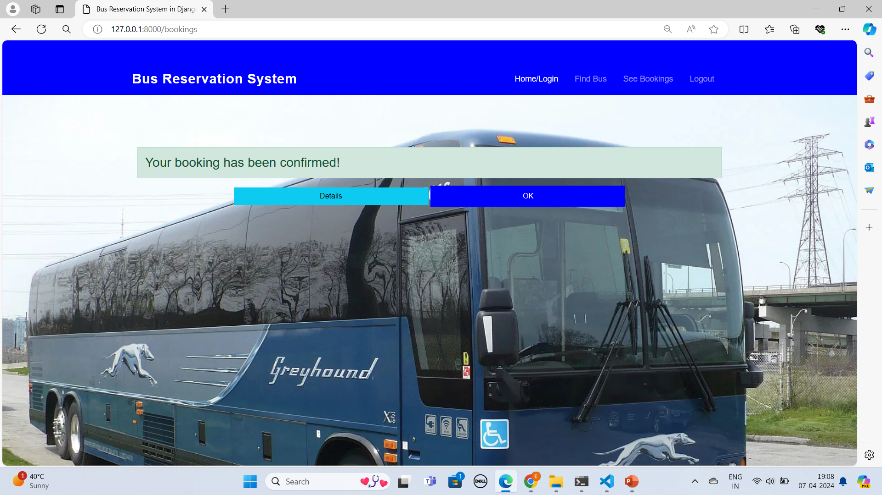
Booking Confirmation-Page

Slide 19
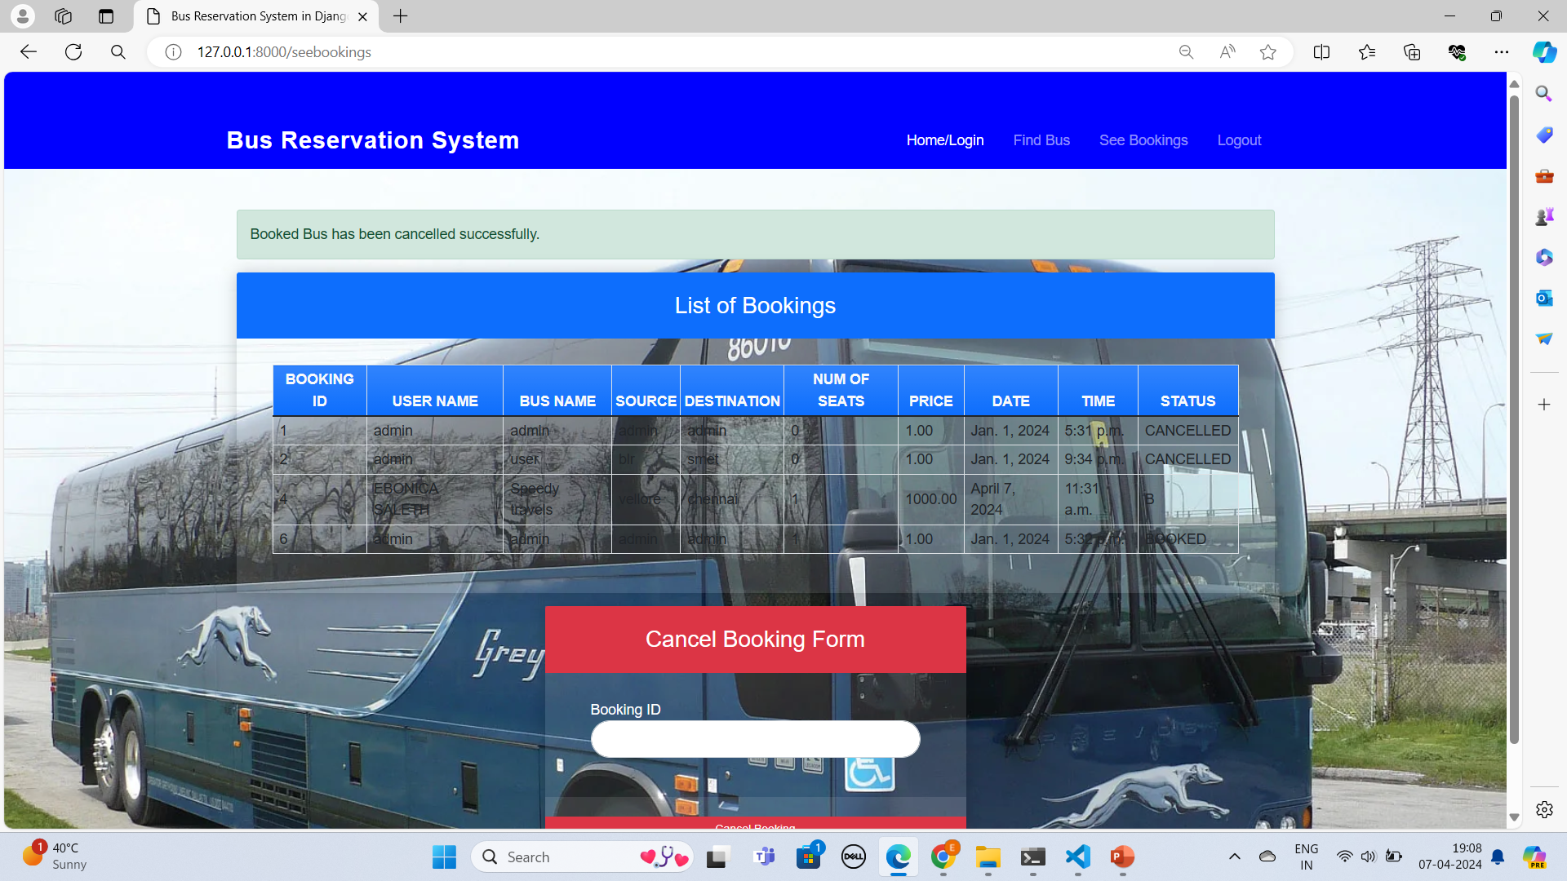
Booking Cancellation-Page

Slide 20
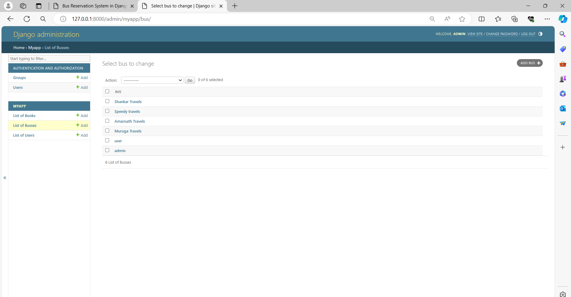
Bus List-Page

Slide 21
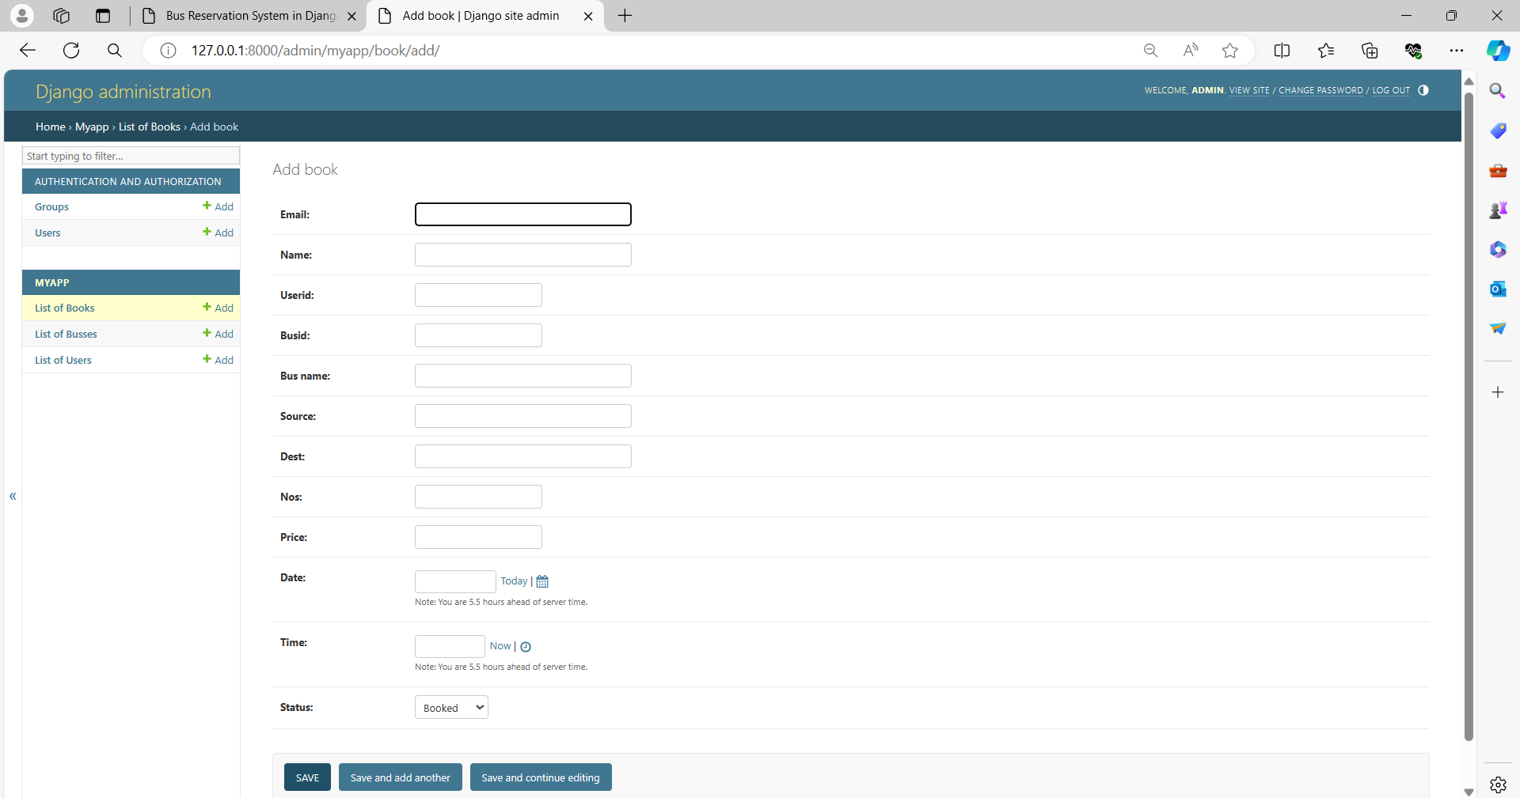
Add Book-Page

Slide 22
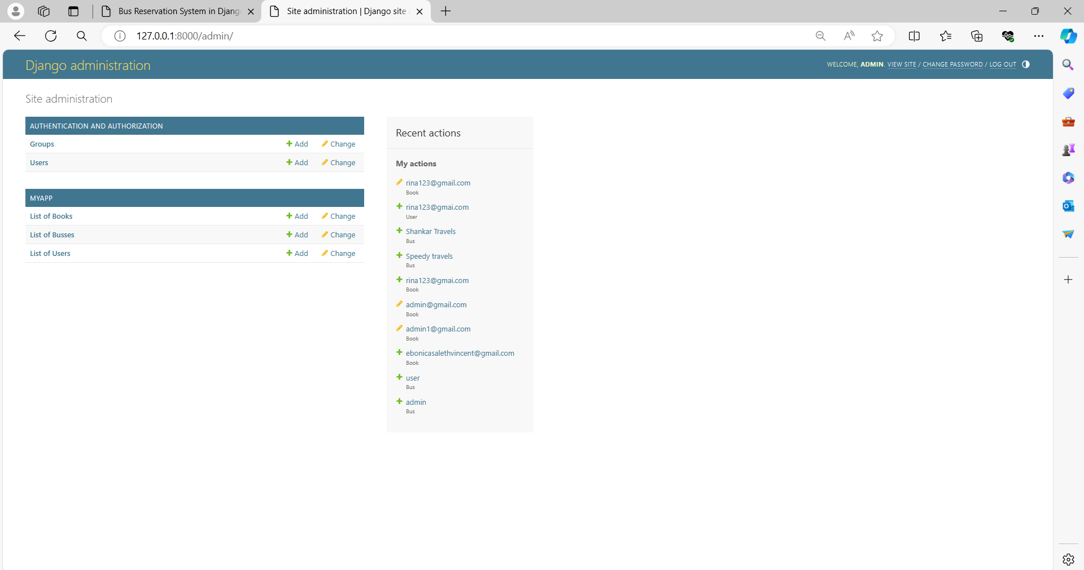
Admin Dashboard-Page

Slide 23
Future Enhancements:
Looking ahead, future enhancements to the Bus Reservation System could significantly enhance its capabilities and user experience. One avenue for improvement is the integration of diverse payment options, spanning from conventional methods to innovative digital solutions like mobile wallets and cryptocurrency. This expansion would cater to a wider user base, offering greater flexibility and convenience during the booking process. By embracing various payment preferences, the system can streamline transactions and enrich the user experience, fostering customer satisfaction and loyalty.
Furthermore, prioritizing accessibility features within the system would ensure inclusivity for users with disabilities or special needs. Incorporating tools such as screen reader compatibility, keyboard navigation shortcuts, and customizable display settings would empower all users to navigate the platform effortlessly. This commitment to accessibility aligns with principles of equity and ensures that the Bus Reservation System remains accessible to everyone, regardless of their abilities or circumstances. By fostering a more inclusive environment, the system can uphold its commitment to serving diverse user demographics and promoting equal access to transportation services.

Slide 24
Conclusion
The Bus Reservation System represents a significant advancement in the realm of bus ticket booking platforms, addressing the myriad challenges faced by both passengers and bus operators. With its user-friendly interface, real-time updates, secure authentication, centralized admin panel, and scalable architecture, the system offers a comprehensive solution that enhances the overall booking experience while streamlining operations for bus operators.
One of the system's key strengths lies in its intuitive interface, which empowers users to effortlessly search for buses, view schedules, check seat availability, and complete bookings across various devices. By providing real-time updates on schedules and seat availability, passengers can make informed decisions and plan their travel with confidence, while bus operators can efficiently manage bookings and maximize fleet utilization.
Moreover, the inclusion of robust authentication mechanisms ensures the security of users' personal data, installing trust and confidence in the platform. The centralized admin panel equips bus operators with the tools they need to efficiently manage schedules, update fares, track bookings, and analyze performance metrics, enabling data-driven decision-making and continuous improvement.
In essence, the Bus Reservation System represents a transformative solution that revolutionizes the bus travel industry, making it more convenient, secure, and efficient for all stakeholders involved. By addressing the pain points of the current booking process and leveraging advanced technologies, the system paves the way for a seamless and enjoyable travel experience for passengers while optimizing operations for bus operators.
Source :

Slide 25
Thank You!
Notes:
Thank You !!

